Slide 1
Sentence Compression for Improved Understanding of Legal Texts
Richard Batstone
August 2019

Slide 2
Outline
Motivation
Related work
Legal corpora
Models
Results
Discussion
Questions

Slide 3
Motivation
Understanding legal rules

Slide 4
We love rules

Slide 5



We love rules
Law is pervasive

Slide 6
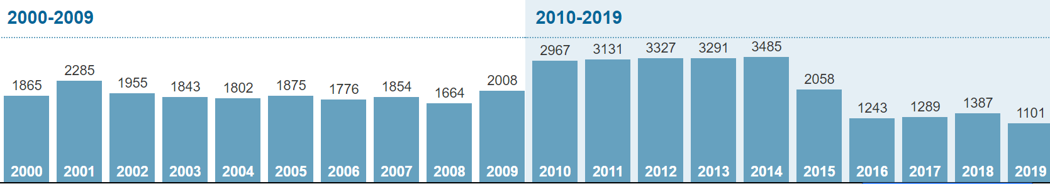
We love rules
Law is pervasive
And there’s lots of it
UK statutory instruments by year:
http://www.legislation.gov.uk/uksi

Slide 7
But we struggle to understand it
50 million words
Unusual language, style and structure

Slide 8
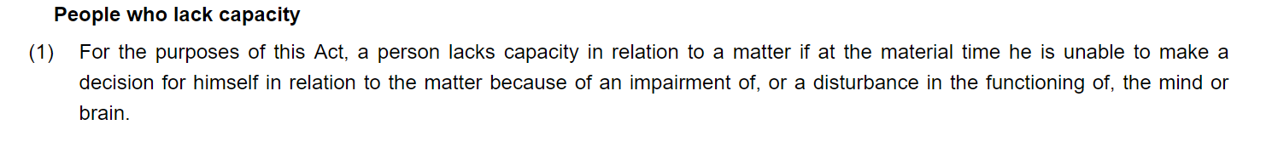
But we struggle to understand it
Mental Capacity Act 2005, section 2(1):
http://www.legislation.gov.uk/ukpga/2005/9/part/1

Slide 9
But we struggle to understand it
1 sentence
50 words
Passive voice
Mental Capacity Act 2005, section 2(1):
http://www.legislation.gov.uk/ukpga/2005/9/part/1

Slide 10
But we struggle to understand it
1 sentence
50 words
Passive voice
Mental Capacity Act 2005, section 2(1):
http://www.legislation.gov.uk/ukpga/2005/9/part/1

Slide 11
Why do we need the extra words?
Mental Capacity Act 2005, section 2(1):
http://www.legislation.gov.uk/ukpga/2005/9/part/1

Slide 12
Why do we need the extra words?
Scope
Mental Capacity Act 2005, section 2(1):
http://www.legislation.gov.uk/ukpga/2005/9/part/1

Slide 13
Why do we need the extra words?
Scope
Specificity
Mental Capacity Act 2005, section 2(1):
http://www.legislation.gov.uk/ukpga/2005/9/part/1

Slide 14
Why do we need the extra words?
Scope
Specificity
Generality
Mental Capacity Act 2005, section 2(1):
http://www.legislation.gov.uk/ukpga/2005/9/part/1

Slide 15
Why do we need the extra words?
Scope
Specificity
Generality
Precision at the expense of readability
Mental Capacity Act 2005, section 2(1):
http://www.legislation.gov.uk/ukpga/2005/9/part/1

Slide 16
Why do we need the extra words?
Legislation serves different audiences:
The public
Administrators / lawyers
Legislators
‘Plain English’ initiatives by themselves aren’t enough to produce legislation that a general reader can understand.

Slide 17

Solution?
Automatic text simplification
Legal language (original text)
Simplified, more readable text

Slide 18
Solution?
Automatic text simplification
compression
I really like spaghetti with sauce
I really like spaghetti with sauce
A sub-task of automatic text simplification

Slide 19
Related Work
Understanding legal rules

Slide 20



Automatic Text Simplification
For:
NLP pre-processing
Second language learners
Assisting readers with low-literacy
As a tool to improve clarity
Ref: Shardlow 2014

Slide 21
Automatic Text Simplification
Text compression is a more constrained task:
The poem was composed by the renowned artist
Ref: Sanja Stajner and Horacio Saggion http://taln.upf.edu/pages/coling2018simplification/

Slide 22
Automatic Text Simplification
Text compression is a more constrained task:
The poem was composed by the artist
(Compression)
The poem was composed by the renowned artist
The famous artist wrote the poem
(Simplification)
Ref: Sanja Stajner and Horacio Saggion http://taln.upf.edu/pages/coling2018simplification/

Slide 23
Automatic Text Compression
Tree pruning vs statistical approaches

Slide 24
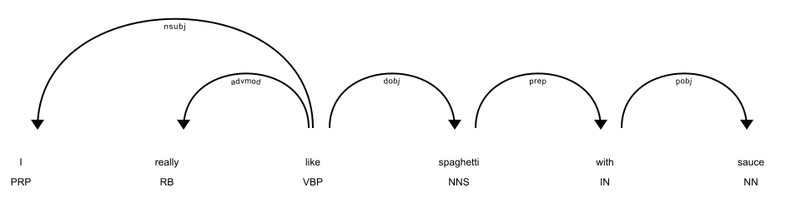
Automatic Text Compression
Tree pruning vs statistical approaches

Slide 25
Automatic Text Compression
Tree pruning vs statistical approaches

Slide 26
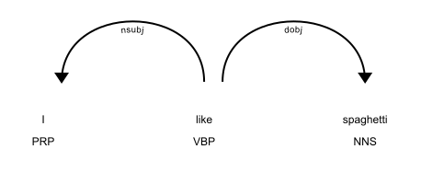
Automatic Text Compression
Tree pruning vs statistical approaches

Slide 27
Automatic Text Compression
Filippova et al. 2013
Constructed a large parallel corpus of uncompressed and compressed sentences.
Filippova et al. 2015
Developed a statistical sequence-to-sequence model to automatically compress sentences.

Slide 28
Automatic Text Compression
Filippova et al. 2015
Treat the problem as sequence labelling task.

Slide 29

Automatic Text Compression
Filippova et al. 2015
Treat the problem as sequence labelling task.
Input:
I really like spaghetti with sauce

Slide 30
Automatic Text Compression
Filippova et al. 2015
Treat the problem as sequence labelling task.
Input:
I really like spaghetti with sauce
Target:
1 0 1 1 0 0

Slide 31
Automatic Text Compression
Filippova et al. 2015
Treat the problem as sequence labelling task.
Input:
I really like spaghetti with sauce
Target:
1 0 1 1 0 0
2 million training examples (news headlines and the first sentences of news articles)
Bi-directional LSTM encoder-decoder model (same framework as neural machine translation)

Slide 32
Legal Corpora
Understanding legal rules

Slide 33
Law is a different domain
Legislative language does not look like ordinary language (that’s the whole point)
We need a parallel corpus of compressions for the legal domain

Slide 34
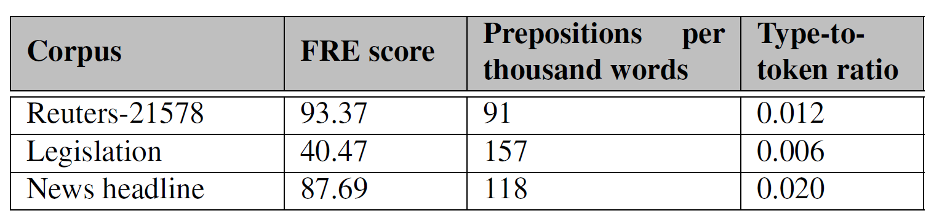
Law is a different domain
Legislative language does not look like ordinary language (that’s the whole point)
We need a parallel corpus of compressions for the legal domain

Slide 35
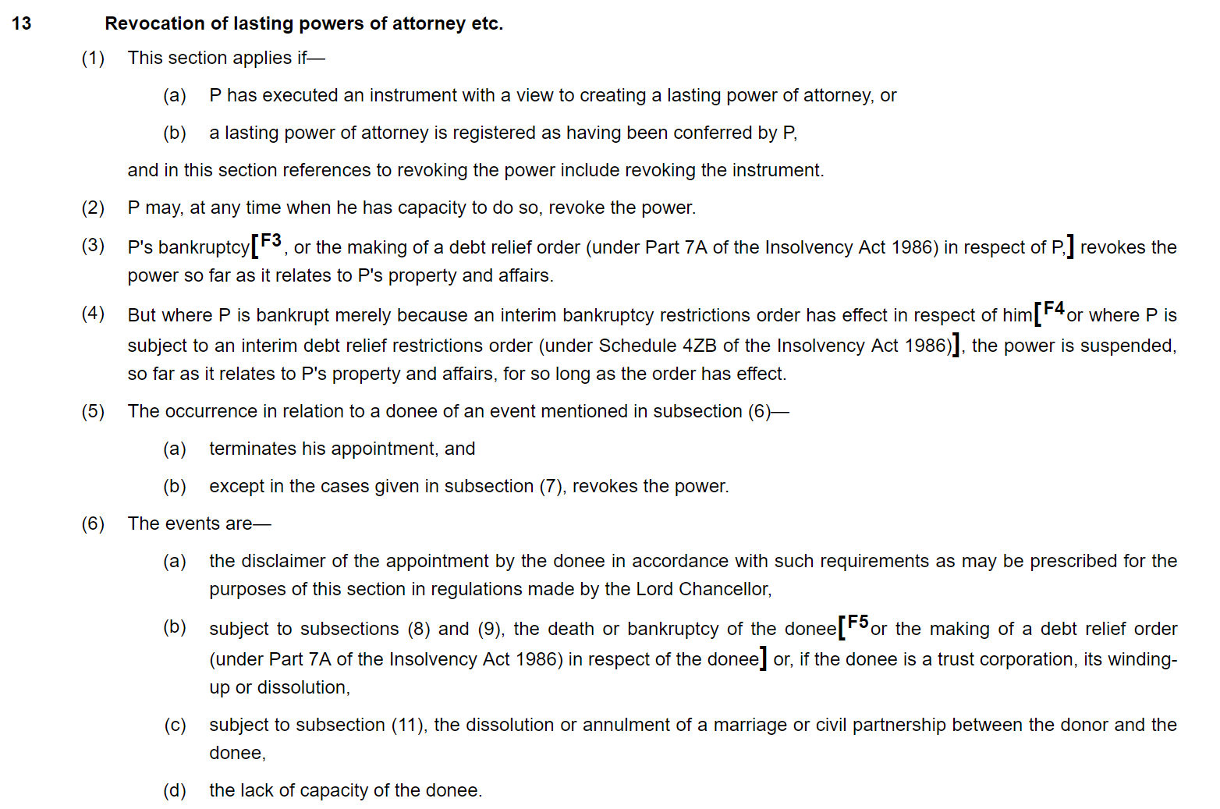
Law is a different domain
Mental Capacity Act 2005, section 13:
http://www.legislation.gov.uk/ukpga/2005/9/part/1

Slide 36
Law is a different domain
Mental Capacity Act 2005, section 13:
http://www.legislation.gov.uk/ukpga/2005/9/part/1

Slide 37
Law is a different domain
Mental Capacity Act 2005, section 13:
http://www.legislation.gov.uk/ukpga/2005/9/part/1

Slide 38
Law is a different domain
Mental Capacity Act 2005, section 13:
http://www.legislation.gov.uk/ukpga/2005/9/part/1

Slide 39
Law is a different domain
Mental Capacity Act 2005, section 13:
http://www.legislation.gov.uk/ukpga/2005/9/part/1

Slide 40
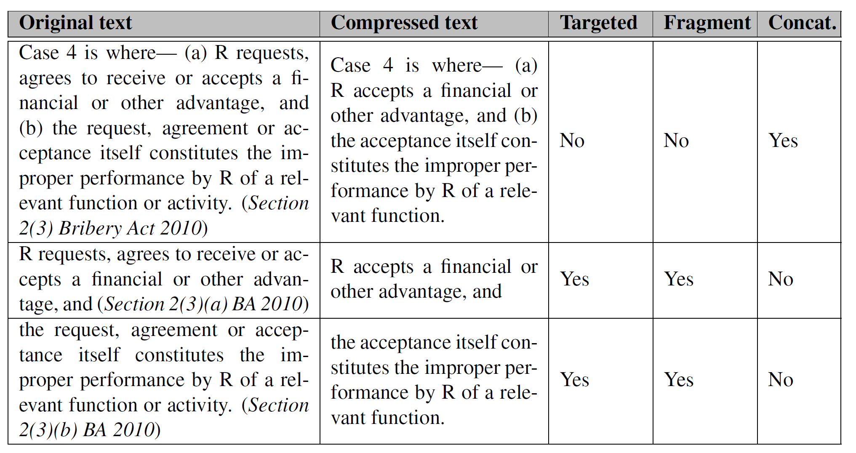
Law is a different domain
We need a parallel corpus of compressions for the legal domain
1,000 compressed and uncompressed pairs
Drawn from a range of legislation
Includes ‘fragments’ and syntactically complete sentences

Slide 41
Law is a different domain
1,000 << 200,000:
Implicit transfer learning:
Pre-trained word embeddings (provide the model with some semantic information)
Pre-trained language models

Slide 42
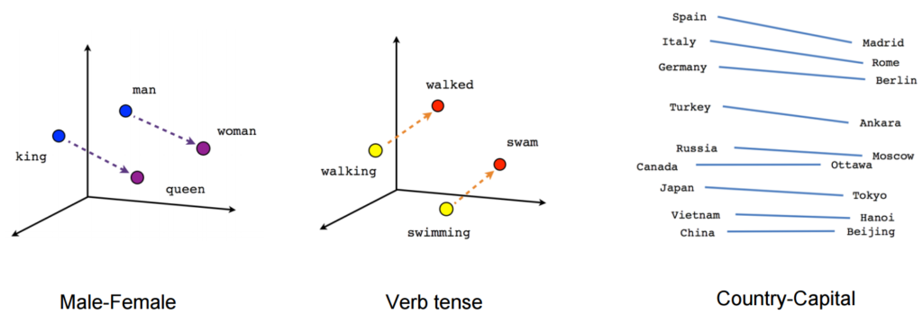
Law is a different domain
1,000 << 200,000:
Implicit transfer learning:
Pre-trained word embeddings (provide the model with some semantic information)
Pre-trained language models
https://nlpforhackers.io/word-embeddings/

Slide 43
Law is a different domain
1,000 << 200,000:
Explicit transfer learning:
Pre-train on a similar task or domain

Slide 44




Law is a different domain
1,000 << 200,000:
Explicit transfer learning:
Pre-train on a similar task or domain
Cat
Dog
Horse
Large dataset (e.g. ImageNet), similar task (object classification)
Target task (small) dataset

Slide 45
Models
Understanding legal rules

Slide 46
Models
Rules-based
Statistical (LSTM) (Filippova 2015 + transfer learning)
Statistical (Transformers, BERT)
Ensemble (Rules and transformers)

Slide 47
Rules-based model
A set of hand-written rules (derived from the training set). Remove:
Text in parentheses
Certain syntactic sub-trees
Common extraneous legal phrases
Certain alternative sub-clauses
Doublets

Slide 48
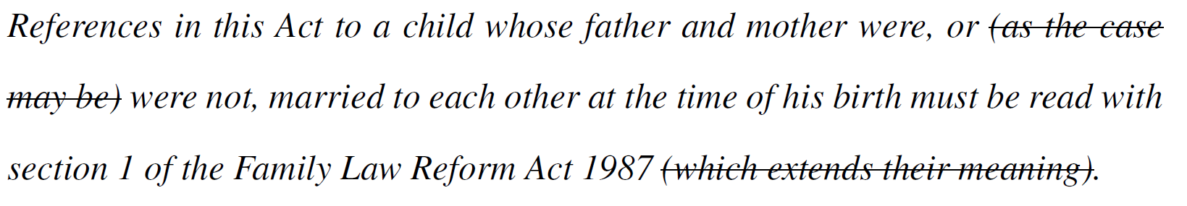
Rules-based model
A set of hand-written rules (derived from the training set). Remove:
Text in parentheses
Certain syntactic sub-trees
Common extraneous legal phrases
Certain alternative sub-clauses
Doublets

Slide 49
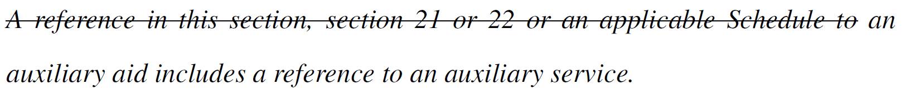
Rules-based model
A set of hand-written rules (derived from the training set). Remove:
Text in parentheses
Certain syntactic sub-trees
Common extraneous legal phrases
Certain alternative sub-clauses
Doublets

Slide 50
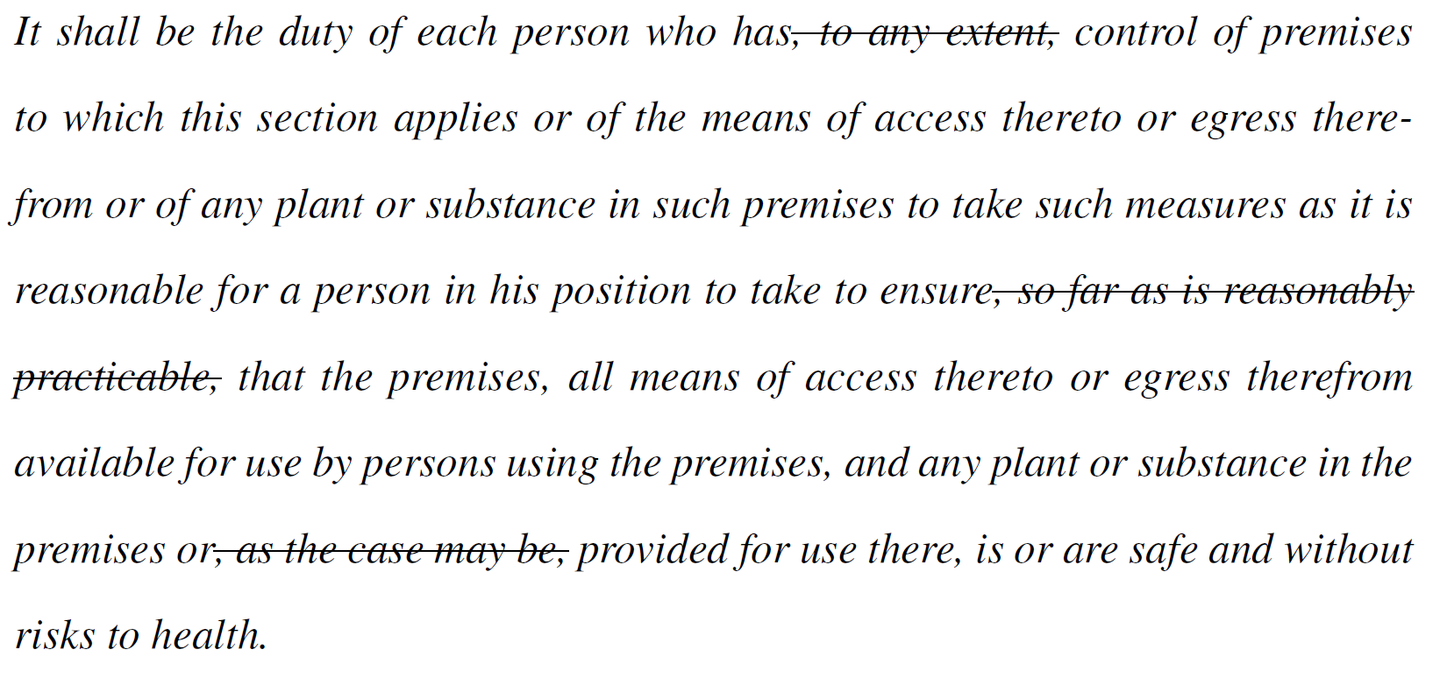
Rules-based model
A set of hand-written rules (derived from the training set). Remove:
Text in parentheses
Certain syntactic sub-trees
Common extraneous legal phrases
Certain alternative sub-clauses
Doublets

Slide 51
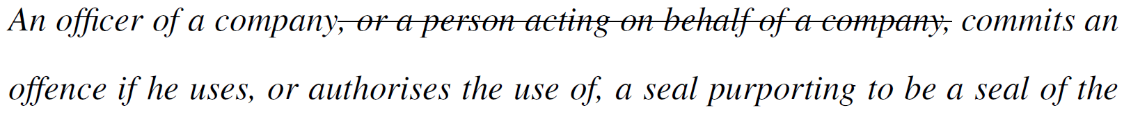
Rules-based model
A set of hand-written rules (derived from the training set). Remove:
Text in parentheses
Certain syntactic sub-trees
Common extraneous legal phrases
Certain alternative sub-clauses
Doublets

Slide 52
Rules-based model
A set of hand-written rules (derived from the training set). Remove:
Text in parentheses
Certain syntactic sub-trees
Common extraneous legal phrases
Certain alternative sub-clauses
Doublets
“Safety and welfare”
“Fit and proper”
“Mother and father”

Slide 53
LSTM model
Two recurrent neural networks:
a network to encode the input
a network to decode the output
network parameters obtained through comparison between network outputs and target outputs (and back-propagation algorithm)

Slide 54
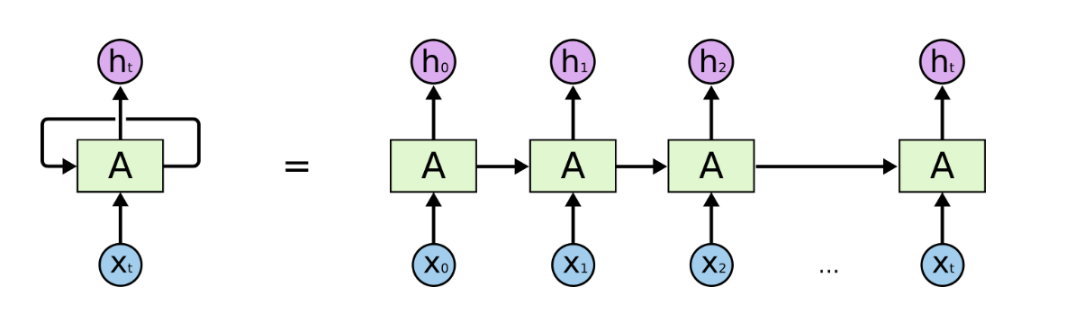
LSTM model
Two recurrent neural networks:
a network to encode the input
a network to decode the output
network parameters obtained through comparison between network outputs and target outputs (and back-propagation algorithm)
Ref: https://colah.github.io/posts/2015-08-Understanding-LSTMs

Slide 55
LSTM model
Uncompressed sentence (tokenized)

Slide 56
LSTM model
Uncompressed sentence (tokenized)
word2vec embedding lookup

Slide 57
LSTM model
Uncompressed sentence (tokenized)
word2vec embedding lookup
Encoder LSTM
Recursively applied to input sequence
Fixed length vector

Slide 58
LSTM model
Uncompressed sentence (tokenized)
word2vec embedding lookup
Encoder LSTM
Recursively applied to input sequence
Fixed length vector
Decoder LSTM
Recursively applied to fixed length vector
Projection into label space

Slide 59
LSTM model
Uncompressed sentence (tokenized)
word2vec embedding lookup
Encoder LSTM
Recursively applied to input sequence
Fixed length vector
Decoder LSTM
Recursively applied to fixed length vector
Projection into label space
Output labels

Slide 60
LSTM model
Uncompressed sentence (tokenized)
word2vec embedding lookup
Encoder has three LSTM layers
Decoder has three LSTM layers
128 nodes per layer
ReLU activation function
Uni-directional
Dropout applied during training (0.2)
Optimised with ADAM (0.002 initial learning rate) and gradient clipping (max norm of 1)
Encoder LSTM
Recursively applied to input sequence
Fixed length vector
Decoder LSTM
Recursively applied to fixed length vector
Projection into label space
Output labels

Slide 61
LSTM model – Fine-tuning
Three part fine-tuning procedure:
Linearly increase learning rate for first 10% of training steps to a maximum, before linearly decreasing
Decrease the learning rate for each model layer
Gradually unfreeze the model layers during training
Ref: Howard and Ruder 2018

Slide 62
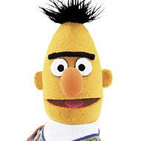
BERT model
(Bidirectional Encoder Representations from Transformers)
A large-scale [language model]
Trained on English Wikipedia and the BooksCorpus
Intended to provide context aware representations of tokens and sequences of tokens
Ref: Devlin et. al. 2018

Slide 63
BERT model
(Bidirectional Encoder Representations from Transformers)
A large-scale [language model]
Trained on English Wikipedia and the BooksCorpus
Intended to provide context aware representations of tokens and sequences of tokens
State-of-the-art(ish) performance on a range of language processing tasks with minimal fine-tuning
I went to the bank to cash a cheque
vs
I went to the bank of the river to retrieve my fishing rod
Ref: Devlin et. al. 2018

Slide 64
BERT model
Transformer encoder-decoder:

Slide 65
BERT model
Transformer encoder-decoder:
Transformers are attention based
(learnt) sets of weights which determine the contribution of each token in the input to:
the representations of other input tokens
each output token

Slide 66
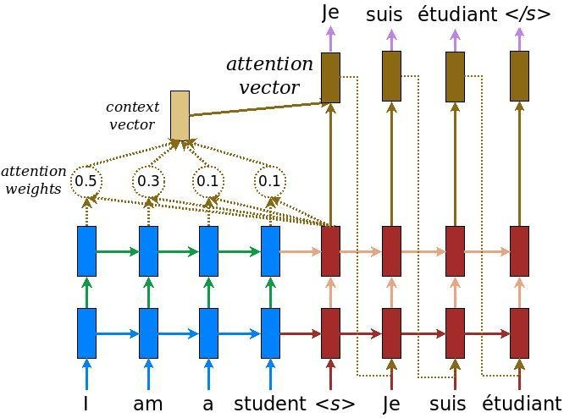
BERT model
Transformer encoder-decoder:
Transformers are attention based
(learnt) sets of weights which determine the contribution of each token in the input to:
the representations of other input tokens
each output token
Ref: https://github.com/tensorflow/nmt

Slide 67
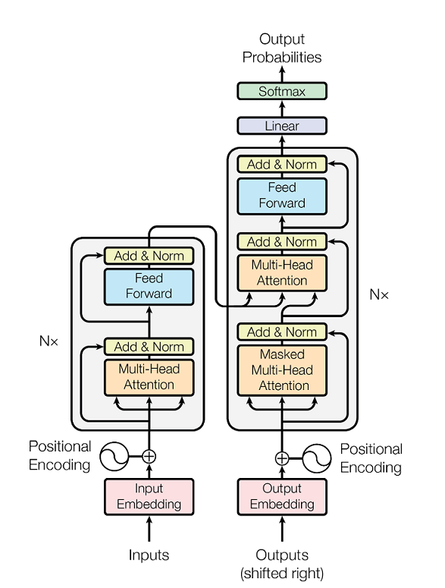
BERT model
Transformer encoder-decoder:
Transformers are attention based
(learnt) sets of weights which determine the contribution of each token in the input to:
the representations of other input tokens
each output token
Ref: Vasvani et. al. 2017

Slide 68
BERT model
Ref: Vasvani et. al. 2017

Slide 69
BERT model
Decoder has three six layers
6 nodes per layer
3 self-attentive heads
3 encoder-attentive heads
2 fully connected layers (size 512)
ReLU activation function
Dropout applied during training (0.1)
Optimised with ADAM (2e⁻⁵ initial learning rate)
Ref: Vasvani et. al. 2017

Slide 70
BERT-rules ensemble model
Pipeline:
Uncompressed text
Apply rules-based compressions
Reconstruct text
Apply BERT model
Reconstruct text

Slide 71
Results
Understanding legal rules

Slide 72
Results – compression ratio
The degree of compression

Slide 73
Results – compression ratio
The degree of compression
Compression ratio
I really like spaghetti with sauce
I really like spaghetti with sauce
1
I really like spaghetti with sauce
I like spaghetti with sauce
0.83
I really like spaghetti with sauce
I like spaghetti
0.5
N.B. target is 0.63

Slide 74
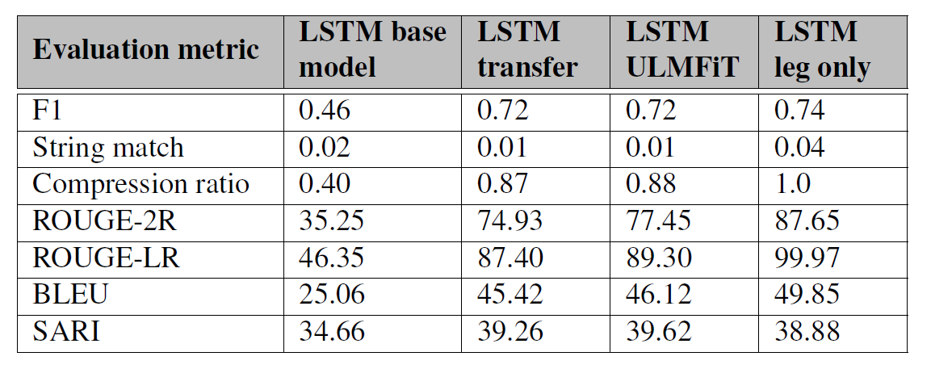
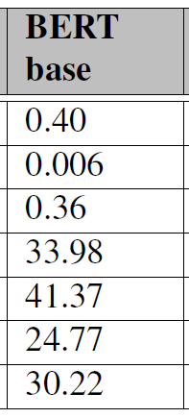
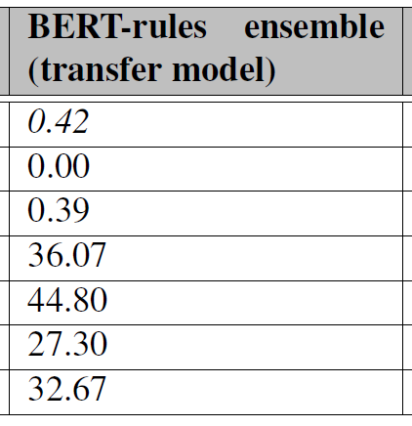
Results – CR 0.35-0.40
(pre-training, no fine-tuning)
(rules ensemble, pre-training, fine-tuning)

Slide 75
Results – CR 0.35-0.40
(pre-training, no fine-tuning)
(rules ensemble, pre-training, fine-tuning)

Slide 76
Results – CR 0.35-0.40
(pre-training, no fine-tuning)
(rules ensemble, pre-training, fine-tuning)

Slide 77
Results – CR 0.35-0.40
For the purposes of the GDPR, the following (and only the following) are “public authorities” and “public bodies” under the law of the United Kingdom-
Input:
For the purposes of the GDPR, the following (and only the following) are “public authorities” and “public bodies” under the law of the United Kingdom-
Target:

Slide 78
Results – CR 0.35-0.40
For the purposes of the GDPR, the following (and only the following) are “public authorities” and “public bodies” under the law of the United Kingdom-
Input:
For the purposes of the GDPR, the following (and only the following) are “public authorities” and “public bodies” under the law of the United Kingdom-
Target:
LSTM base:
For the purposes of the GDPR, the following (and only the following) are “public authorities” and “public bodies” under the law of the United Kingdom-

Slide 79
Results – CR 0.35-0.40
For the purposes of the GDPR, the following (and only the following) are “public authorities” and “public bodies” under the law of the United Kingdom-
Input:
For the purposes of the GDPR, the following (and only the following) are “public authorities” and “public bodies” under the law of the United Kingdom-
Target:
LSTM base:
For the purposes of the GDPR, the following (and only the following) are “public authorities” and “public bodies” under the law of the United Kingdom-
BERT base:
For the purposes of the GDPR, the following (and only the following) are “public authorities” and “public bodies” under the law of the United Kingdom-

Slide 80
Results – CR 0.35-0.40
For the purposes of the GDPR, the following (and only the following) are “public authorities” and “public bodies” under the law of the United Kingdom-
Input:
For the purposes of the GDPR, the following (and only the following) are “public authorities” and “public bodies” under the law of the United Kingdom-
Target:
LSTM base:
For the purposes of the GDPR, the following (and only the following) are “public authorities” and “public bodies” under the law of the United Kingdom-
BERT base:
For the purposes of the GDPR, the following (and only the following) are “public authorities” and “public bodies” under the law of the United Kingdom-
BERT-rules ensemble (pre-trained):
For the purposes of the GDPR, the following (and only the following) are “public authorities” and “public bodies” under the law of the United Kingdom-

Slide 81
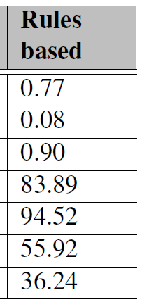
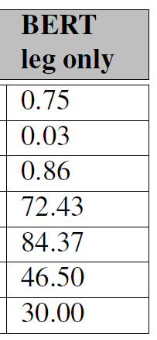
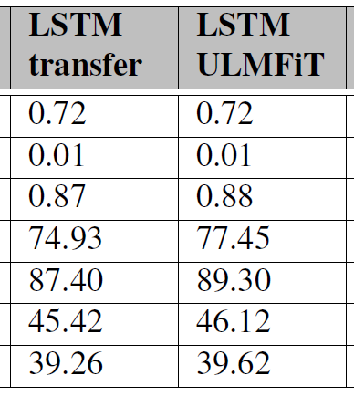
Results – CR 0.85-0.90
(no pre-training)
(pre-training, ordinary fine-tuning)
(pre-training, fancy fine-tuning)

Slide 82
Results – CR 0.85-0.90
(no pre-training)
(pre-training, ordinary fine-tuning)
(pre-training, fancy fine-tuning)

Slide 83
Results – CR 0.85-0.90
A person appointed under paragraph 1(e) may resign from the Committee by giving notice to the Committee
Input:
Target:
A person appointed under paragraph 1(e) may resign from the Committee by giving notice to the Committee
LSTM transfer:
A person appointed under paragraph 1(e) may resign from the Committee by giving notice to the Committee

Slide 84
Results – CR 0.85-0.90
A person appointed under paragraph 1(e) may resign from the Committee by giving notice to the Committee
Input:
Target:
A person appointed under paragraph 1(e) may resign from the Committee by giving notice to the Committee
LSTM transfer:
A person appointed under paragraph 1(e) may resign from the Committee by giving notice to the Committee
A person appointed under paragraph 1(e) may resign from the Committee by giving notice to the Committee
LSTM ULMFiT:

Slide 85
Results – CR 0.85-0.90
A person appointed under paragraph 1(e) may resign from the Committee by giving notice to the Committee
Input:
Target:
A person appointed under paragraph 1(e) may resign from the Committee by giving notice to the Committee
LSTM transfer:
A person appointed under paragraph 1(e) may resign from the Committee by giving notice to the Committee
A person appointed under paragraph 1(e) may resign from the Committee by giving notice to the Committee
LSTM ULMFiT:
BERT leg only:
A person appointed under paragraph 1(e) may resign from the Committee by giving notice to the Committee

Slide 86
Results – CR 0.85-0.90
A person appointed under paragraph 1(e) may resign from the Committee by giving notice to the Committee
Input:
Target:
A person appointed under paragraph 1(e) may resign from the Committee by giving notice to the Committee
LSTM transfer:
A person appointed under paragraph 1(e) may resign from the Committee by giving notice to the Committee
A person appointed under paragraph 1(e) may resign from the Committee by giving notice to the Committee
LSTM ULMFiT:
BERT leg only:
A person appointed under paragraph 1(e) may resign from the Committee by giving notice to the Committee
Rules:
A person appointed under paragraph 1(e) may resign from the Committee by giving notice to the Committee

Slide 87
Results – CR 0.85-0.90
Input:
application under part 4A which, if granted, would result, or would be capable of resulting, in a person becoming a ring-fenced body.
Target:
application under part 4A which, if granted, would result, or would be capable of resulting, in a person becoming a ring-fenced body.
Rules:
application under part 4A which, if granted, would result, or would be capable of resulting, in a person becoming a ring-fenced body.

Slide 88
Results – CR 0.85-0.90
Input:
a board (which must include the chairman and chief executive) whose members are the scheme manager’s directors
Target:
a board (which must include the chairman and chief executive) whose members are the scheme manager’s directors
Rules:
a board (which must include the chairman and chief executive) whose members are the scheme manager’s directors

Slide 89
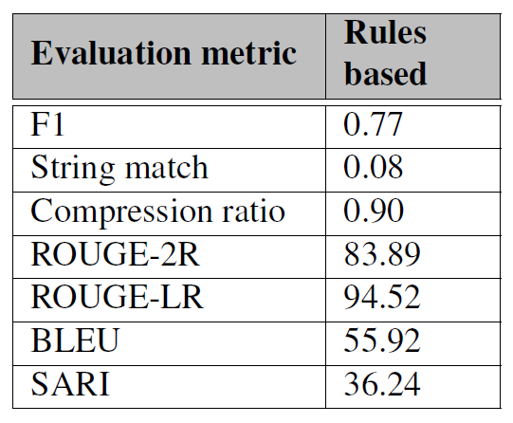
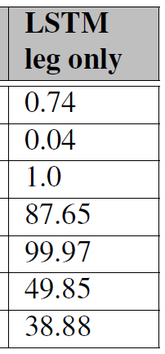
Results – LSTM no pre-training

Slide 90
Results – LSTM no pre-training

Slide 91
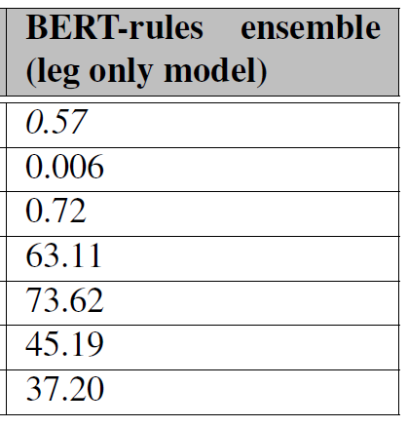
Results – CR 0.72
(Closest to 0.63 target)

Slide 92
Results – CR 0.72
For the purposes of the GDPR, the following (and only the following) are “public authorities” and “public bodies” under the law of the United Kingdom-
Input:
For the purposes of the GDPR, the following (and only the following) are “public authorities” and “public bodies” under the law of the United Kingdom-
Target:
BERT-rules ensemble (no pre-training):
For the purposes of the GDPR, the following (and only the following) are “public authorities” and “public bodies” under the law of the United Kingdom-

Slide 93
Results – Summary
CR 0.85 – 0.9:
Rules-based model
F1 0.77, SARI 36.24
CR 0.7 – 0.75:
BERT-rules ensemble (without pre-training)
F1 0.57, SARI 37.20
CR 0.35 – 0.4:
BERT-rules ensemble (with pre-training)
F1 0.42, SARI 32.67

Slide 94
Results – Summary
CR 0.85 – 0.9:
Rules-based model
F1 0.77, SARI 36.24
High precision, but inflexible
CR 0.7 – 0.75:
BERT-rules ensemble (without pre-training)
F1 0.57, SARI 37.20
Both typically do well where compression can be achieved by removing words from the start of end of the sequence
CR 0.35 – 0.4:
BERT-rules ensemble (with pre-training)
F1 0.42, SARI 32.67

Slide 95
Results – Summary
CR 0.85 – 0.9:
Rules-based model
F1 0.77, SARI 36.24
High precision, but inflexible
CR 0.7 – 0.75:
BERT-rules ensemble (without pre-training)
F1 0.57, SARI 37.20
Both typically do well where compression can be achieved by removing words from the start of end of the sequence
CR 0.35 – 0.4:
BERT-rules ensemble (with pre-training)
F1 0.42, SARI 32.67
Selected for extrinsic evaluation:
Embed model in a question-answer task
Ask human reviewers to assess answers:
grammatical?
answered the question?

Slide 96
Results – Summary
CR 0.85 – 0.9:
Rules-based model
F1 0.77, SARI 36.24
High precision, but inflexible
CR 0.7 – 0.75:
BERT-rules ensemble (without pre-training)
F1 0.57, SARI 37.20
Both typically do well where compression can be achieved by removing words from the start of end of the sequence
CR 0.35 – 0.4:
BERT-rules ensemble (with pre-training)
F1 0.42, SARI 32.67
Selected for extrinsic evaluation:
Embed model in a question-answer task
Ask human reviewers to assess answers:
grammatical?
answered the question?
Results show compressions no less grammatical, but didn’t assist with question answering

Slide 97
Discussion
Understanding legal rules

Slide 98
Effectiveness of transfer learning
Implicit transfer learning:
word2vec vectors (LSTM models)
BERT language model (BERT models)

Slide 99
Effectiveness of transfer learning
Implicit transfer learning:
word2vec vectors (LSTM models)
BERT language model (BERT models)
Little difference in base models
But word2vec vectors require pre-training (to avoid model collapse)

Slide 100
Effectiveness of transfer learning
Explicit transfer learning:
Essential for LSTM model
But not that effective overall

Slide 101
Effectiveness of transfer learning
Explicit transfer learning:
Essential for LSTM model
But not that effective overall
Little difference between ordinary fine-tuning and ULMFiT
Model with the closest compression ratio was not pre-trained

Slide 102
Effectiveness of transfer learning
Explicit transfer learning:
Essential for LSTM model
But not that effective overall
Little difference between ordinary fine-tuning and ULMFiT
Model with the closest compression ratio was not pre-trained
Suggests too great a difference between:
source domain (news articles)
target domain (legislation)
source task (compression of sentences)
target task (compression of sentences and fragments)

Slide 103
Effectiveness of transfer learning
How to make it better?

Slide 104
Effectiveness of transfer learning
How to make it better?
Expand the legislative corpus
(But law always likely to be a low-resource domain)

Slide 105
Effectiveness of transfer learning
How to make it better?
Expand the legislative corpus
Augment pre-training task
(But law always likely to be a low resource domain)
Sub-select pre-training data

Slide 106

Effectiveness of transfer learning
How to make it better?
Expand the legislative corpus
Augment pre-training task
Develop a legal domain language model
(But law always likely to be a low resource domain)
Sub-select pre-training data
Enough data?

Slide 107
Effectiveness of transfer learning
How to make it better?
Expand the legislative corpus
Augment pre-training task
Develop a legal domain language model
Focus on smarter rules-based models
(But law always likely to be a low resource domain)
Sub-select pre-training data
Enough data?
Continue to develop ensemble models

Slide 108
Questions
Understanding legal rules

